Slide 1
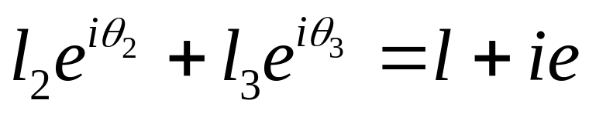
Position Analysis of a RRRP Slider Crank Using Complex Numbers
Q
Im
l₅
θ₃
θ₃
θ₅
l₂
l₃
P
θ₂
e =l₄
Re
O
l=l₁
Viewing the point P from two directions in the complex plane
Note that actually e=l₄ and l=l₁

Slide 2



Position Analysis of a RRRP Slider Crank Using Complex Numbers
Q
Im
l₅
θ₃
θ₃
θ₅
l₂
l₃
P
θ₂
e =l₄
Re
O
l=l₁
Separating the real
And the imaginary parts
We have two unknowns
And two scalar equations to solve for them

Slide 3
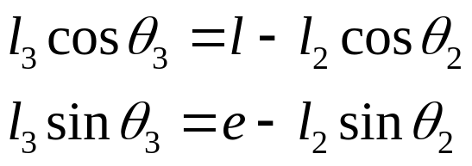
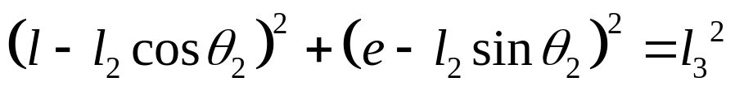
Position Analysis of a RRRP Slider Crank Using Complex Numbers
Q
Im
l₅
θ₃
θ₃
θ₅
l₂
l₃
P
θ₂
e =l₄
Re
O
l=l₁
Rearranging terms
Squaring and adding

Slide 4
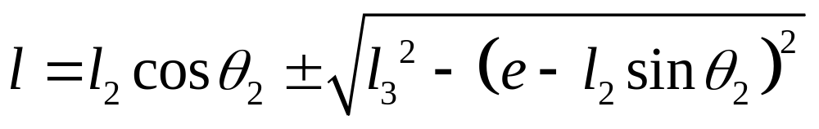
Position Analysis of a 4 bar RRRR Linkage Using Complex Numbers
Q
Im
l₅
θ₃
θ₃
θ₅
l₂
l₃
P
θ₂
e =l₄
Re
O
l
l=l₁
Expanding and rearranging we get two roots

Slide 5
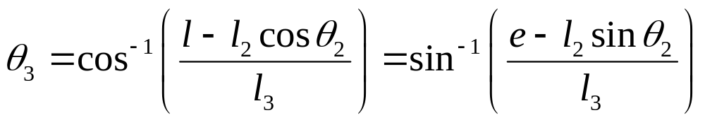
Position Analysis of a RRRP Slider Crank Using Complex Numbers
Q
Im
l₅
θ₃
θ₃
θ₅
l₂
l₃
P
θ₂
e =l₄
Re
O
l
l=l₁
We now get
The signs of sinθ₃ and cosθ₃ will let us determine the quadrant in which θ₃ lies

